Slide 1
DIETARY MANAGEMENT
Submitted by
Anuchitra
Janani
Renukha

Slide 2
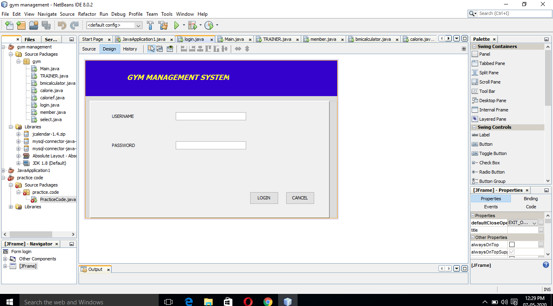
Design of login page

Slide 3
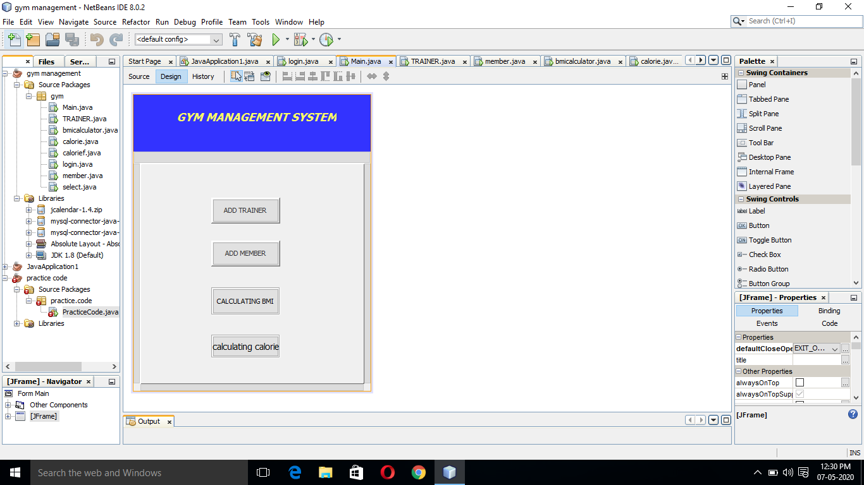
Design of main page

Slide 4
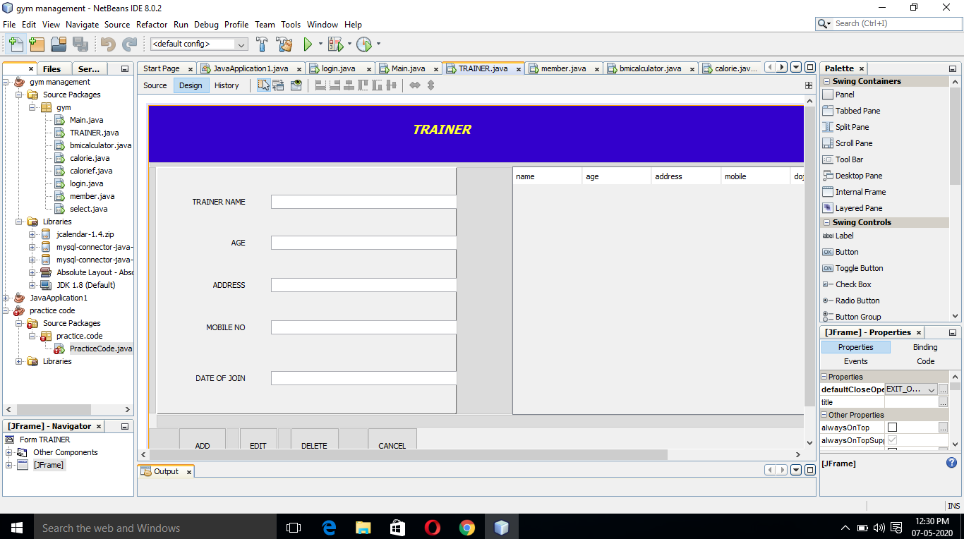
Design of trainer page

Slide 5
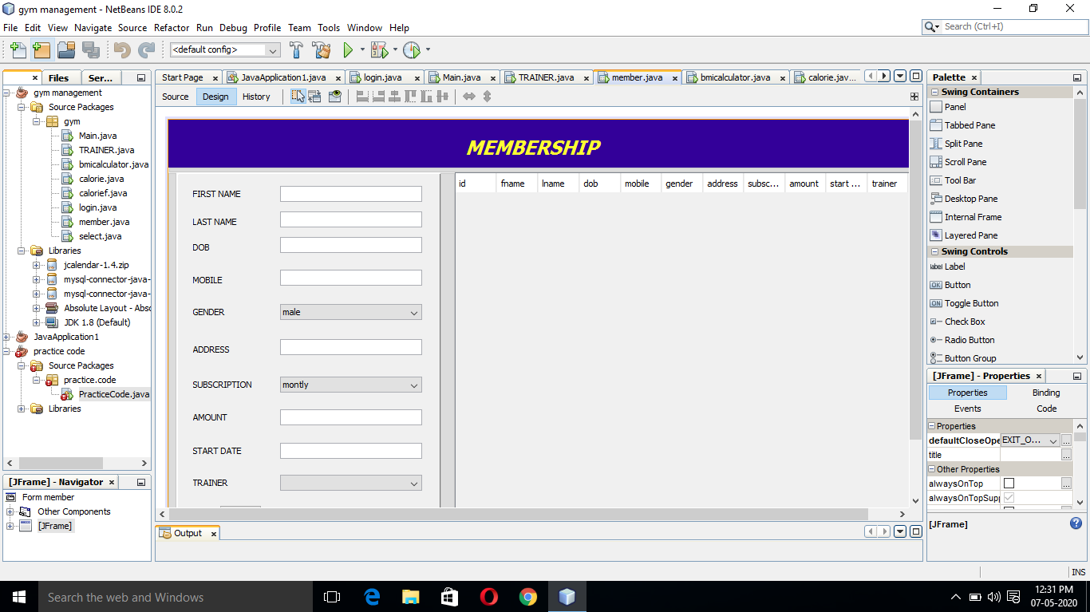
Design of membership page

Slide 6
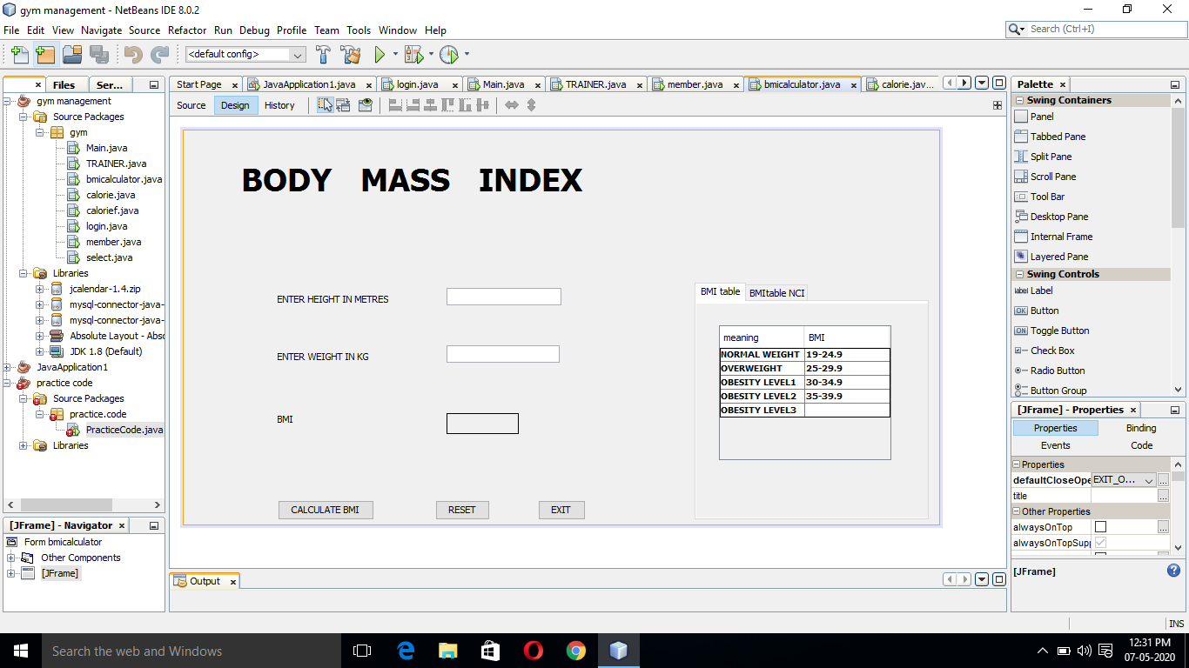
Design of BMI calculation

Slide 7
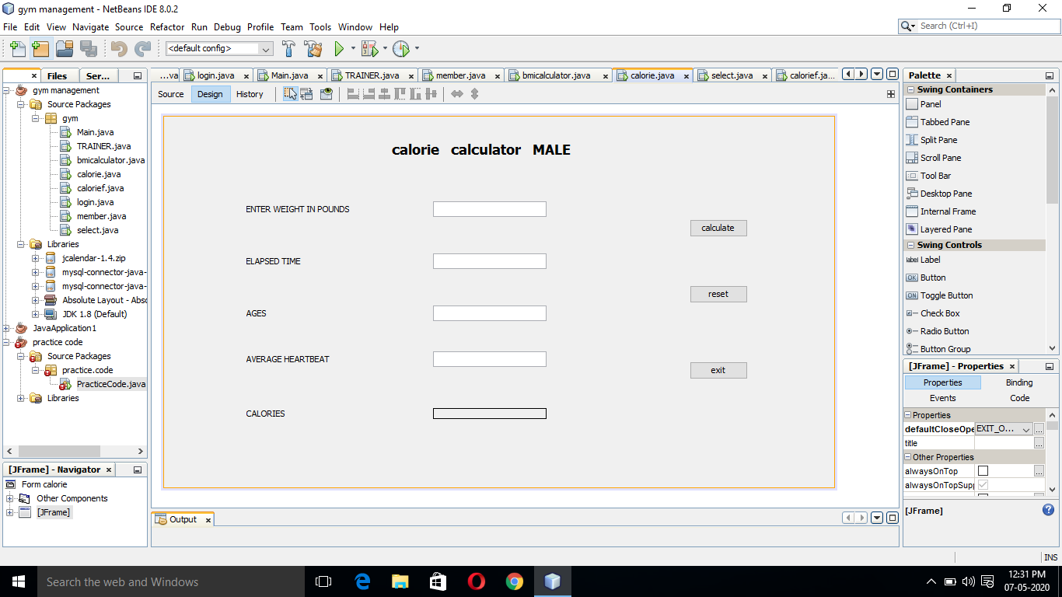
Design of calorie calculation

Slide 8
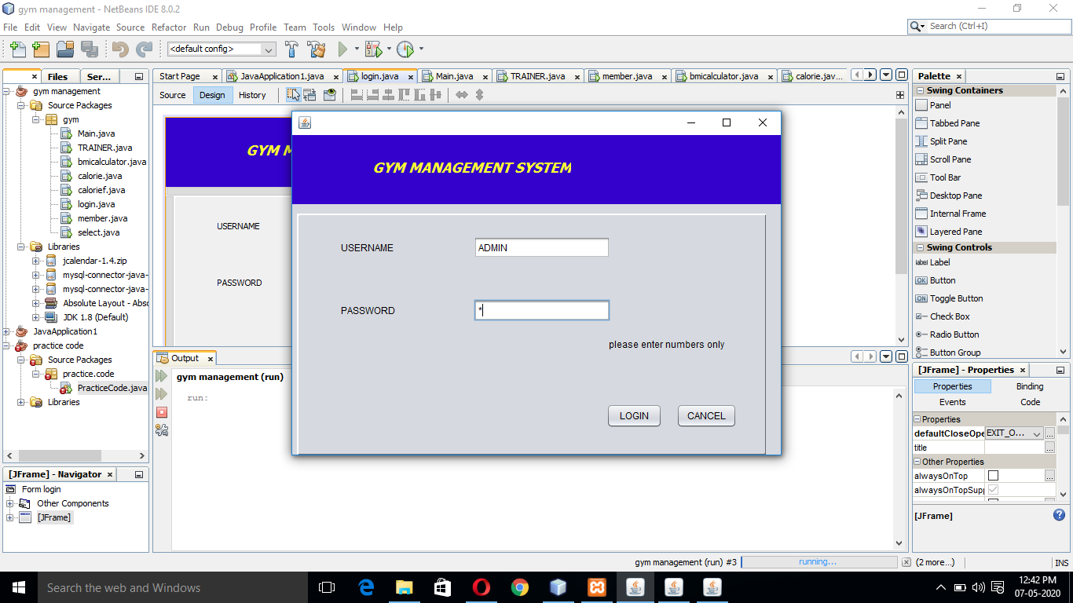
While running a program it will lead to login page first asking to enter the username and password details (exceptional handling is performed)

Slide 9
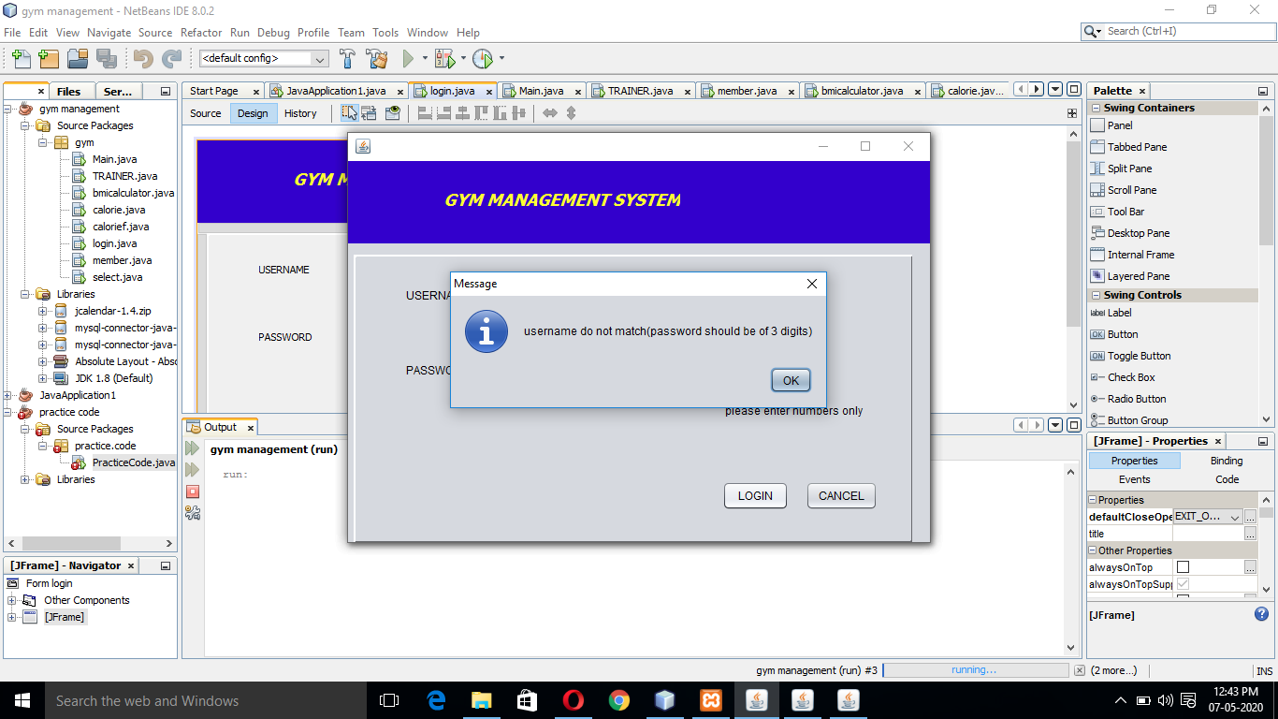
Asking to enter correct username and password

Slide 10
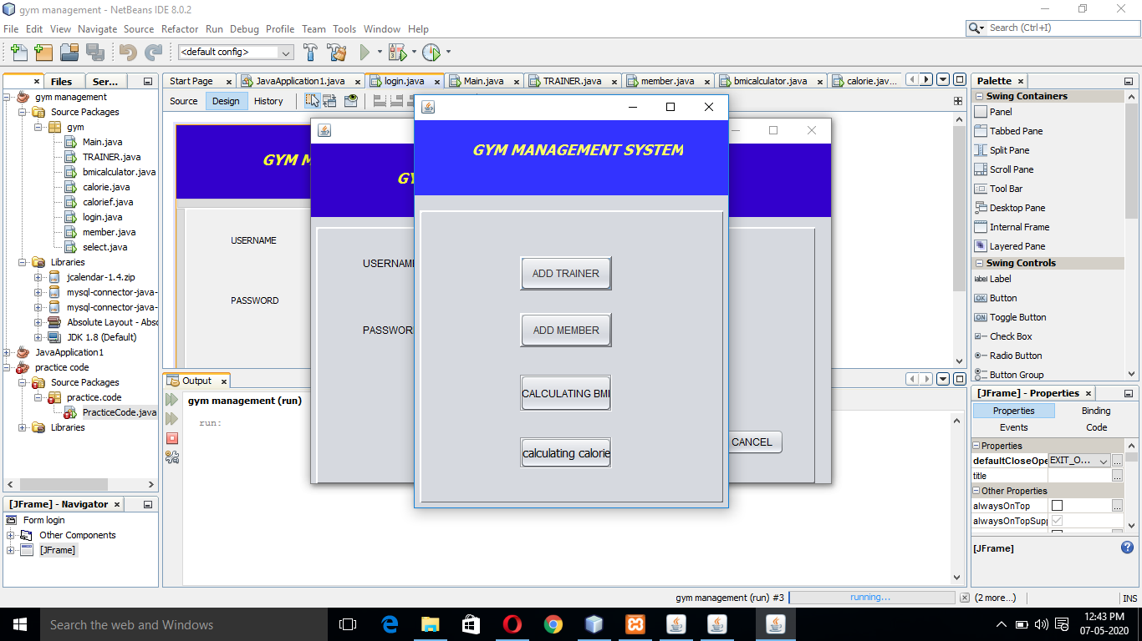
Once login;it direct us to main page displaying option for further details

Slide 11
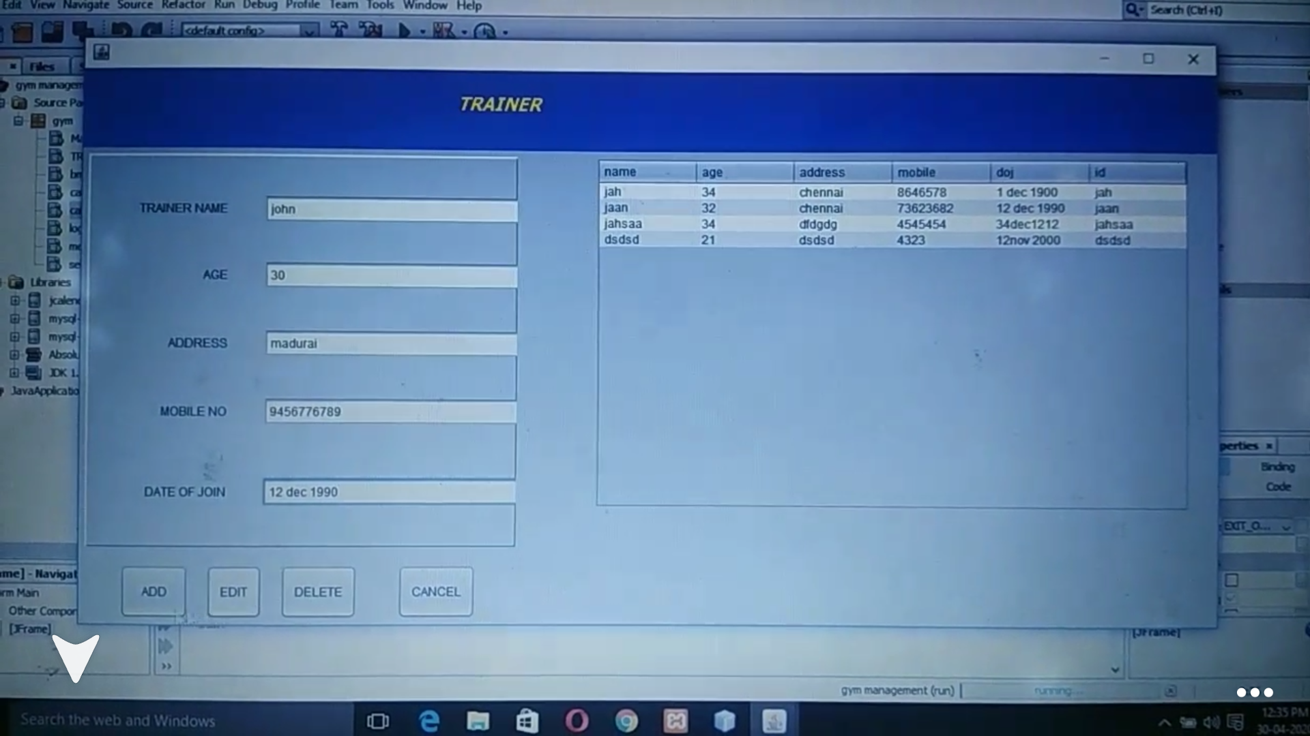
Trainer page with all details and already added trainers are displayed on the right end

Slide 12
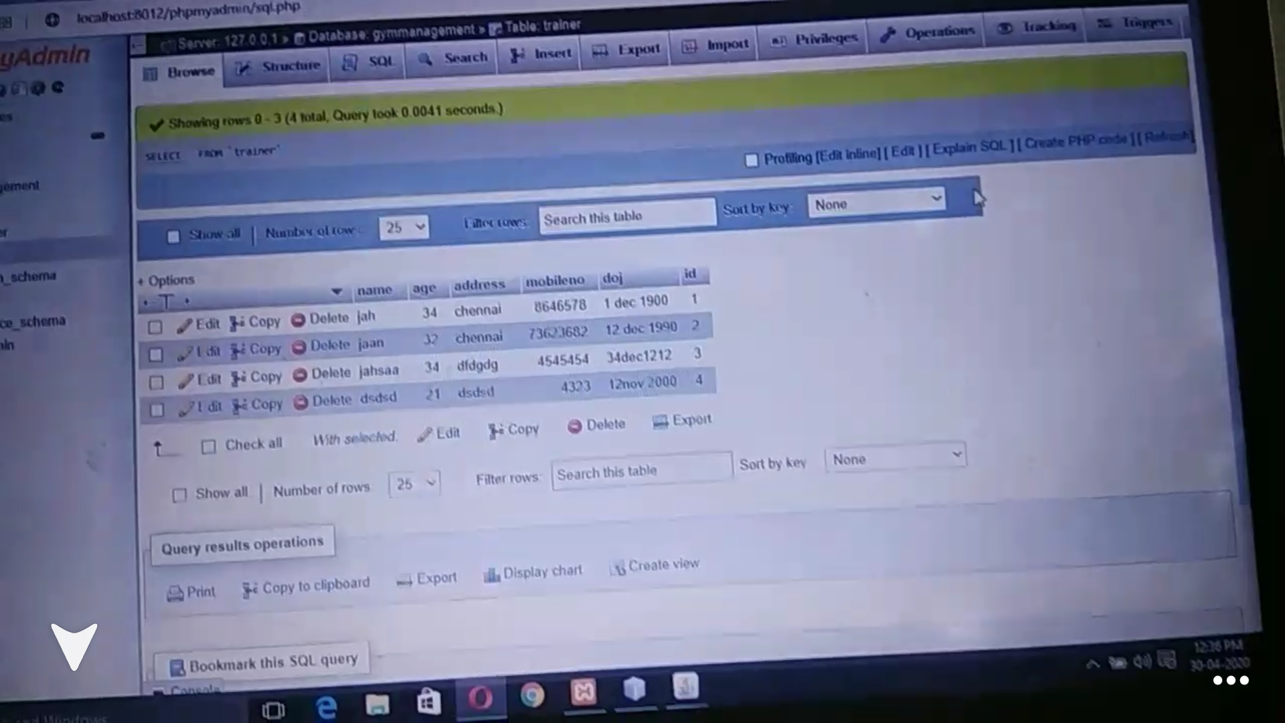
Database for trainer table

Slide 13
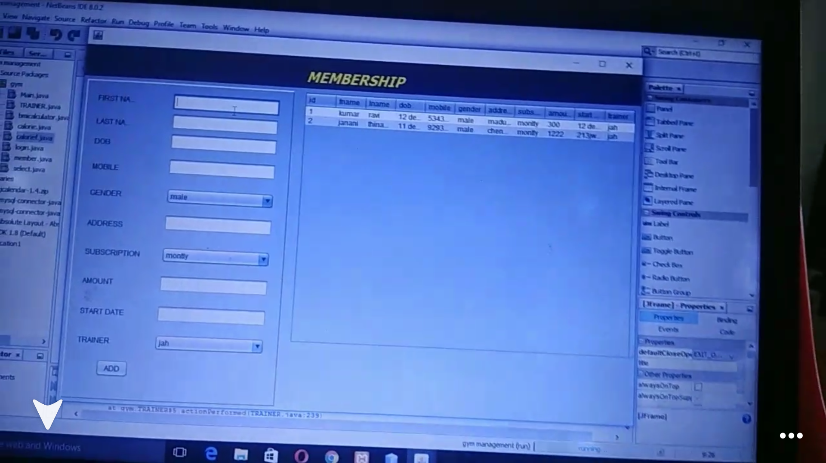
Membership page with all details of member and already added members are displayed on right end

Slide 14
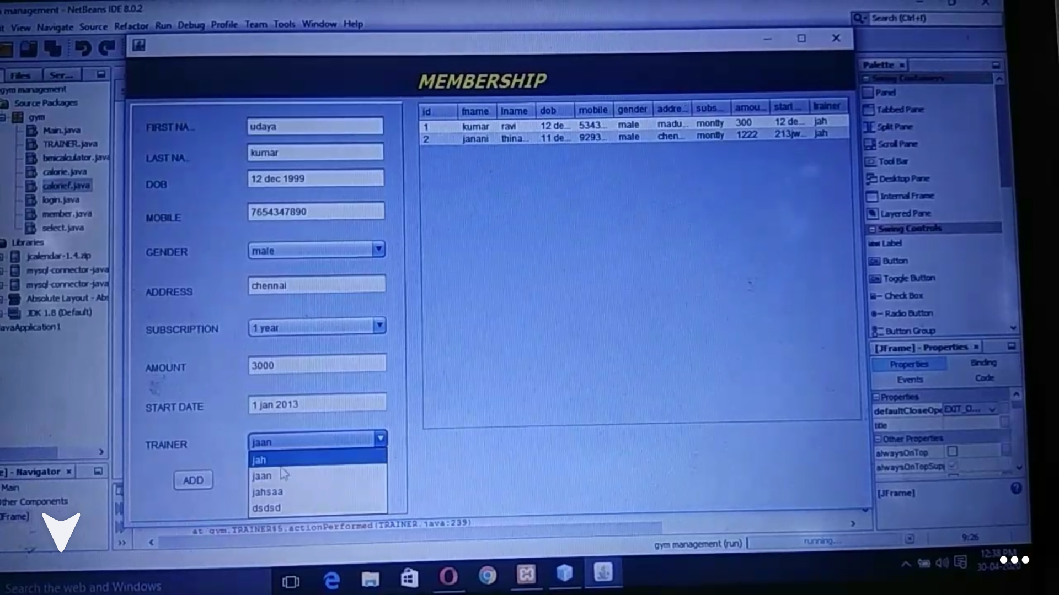
Drop down box furnished with name of the trainer added in the trainer page

Slide 15
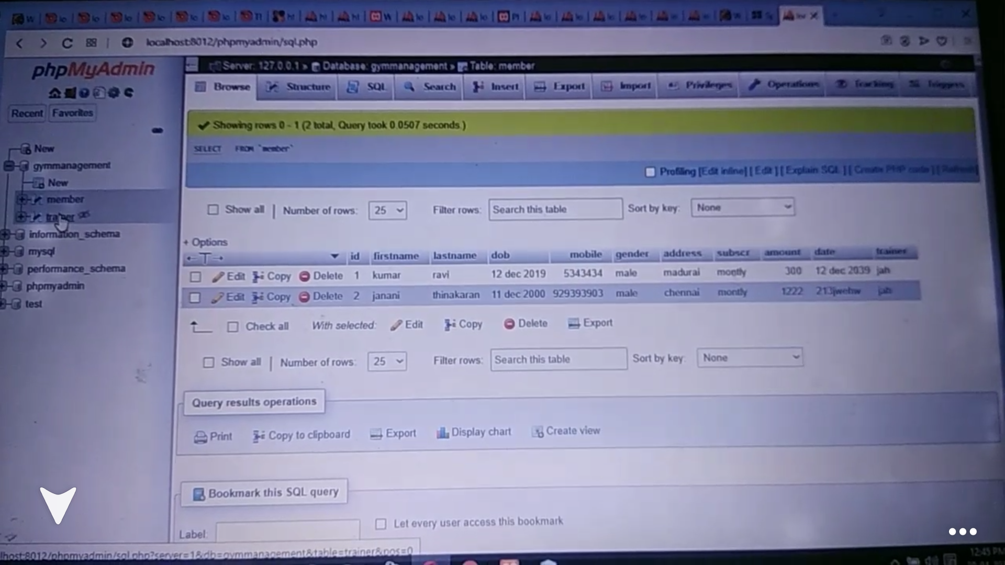
Database for membership table

Slide 16
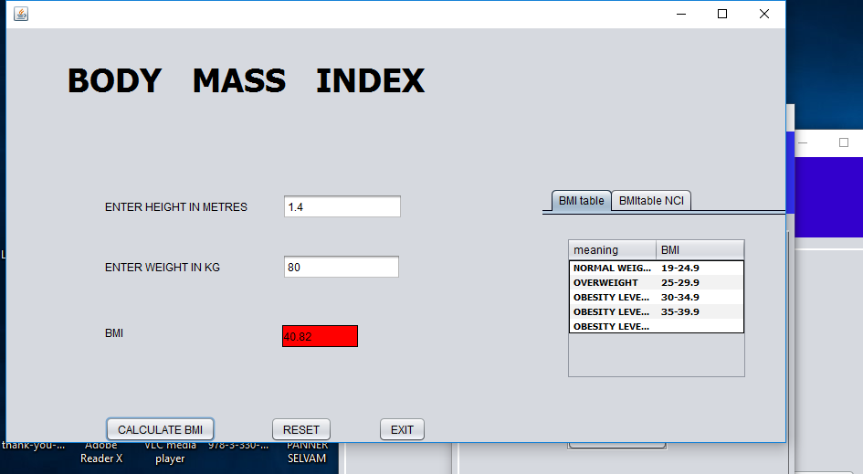
BMI calculation

Slide 17
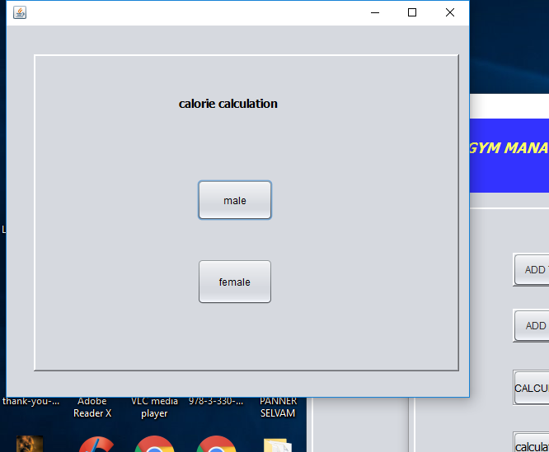
.

Slide 18
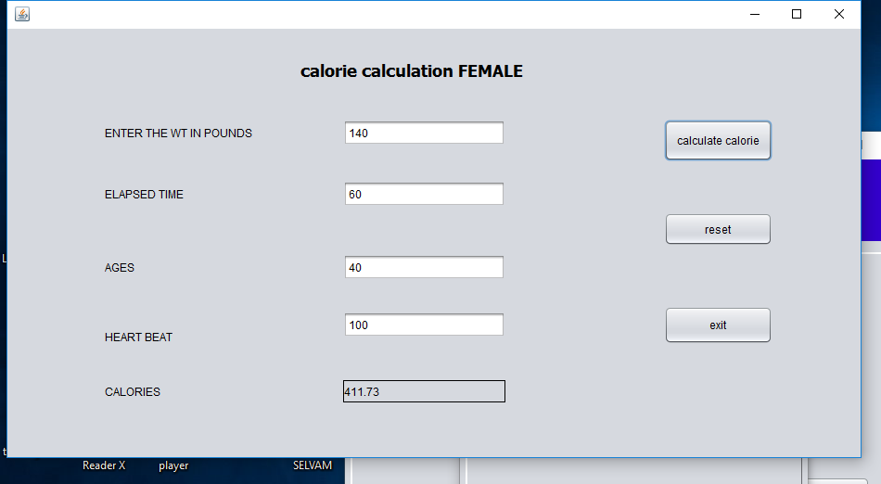
Calorie calculation

Slide 19
Thank you
.

